Slide 1
2025
NEW YEAR NEW ME

Slide 2

Healthy body
Workout at least three times a week
Do Pilates
Drink 2 liters of water daily
Drink lemon water every day
Eat healthy
Exfoliate 2 times a week
Have a shower every night before bed
Get at least 8 hours of sleep every day
Moisturize every day
WAX

Slide 3
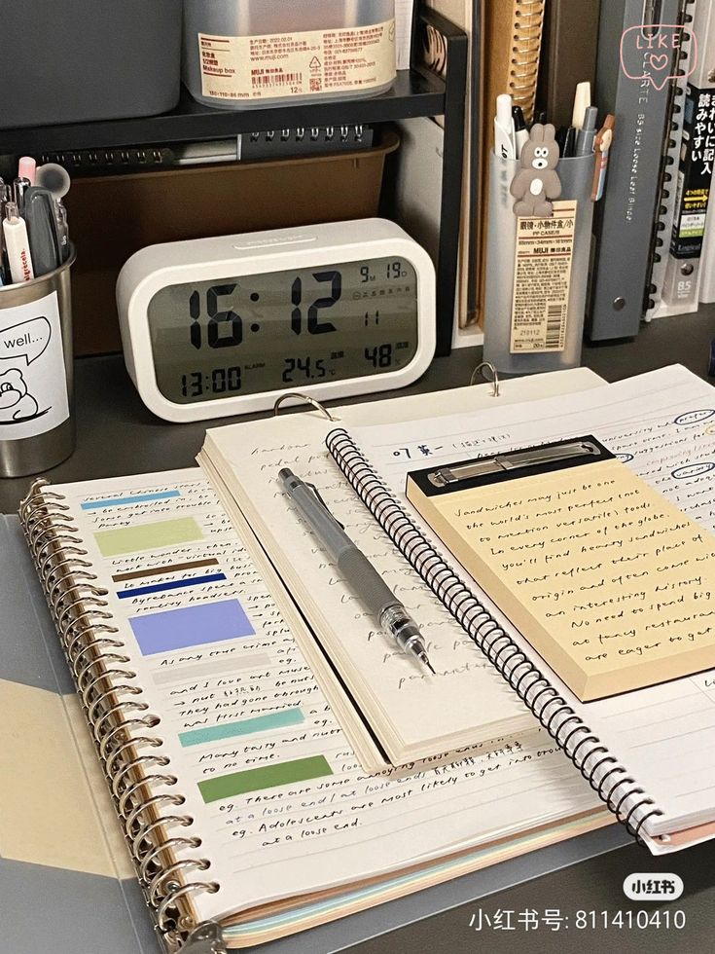
Education
Read books about geography, history, economics, phycology etc.
Study every day for college at least an hour
Reconnect with English
Do homework
Read some classic literature

Slide 4

Healthy Mind
Listen to motivating podcasts
Journal every night
Read self improvement books
Spend less time on my phone
Meditate
Step out of my comfort zone
Sing daily
Do self criticism

Slide 5

Take care of myself
Have a reset day
Spend time with my self
Put my needs first
Discipline so my goals can come true

